Slide 1
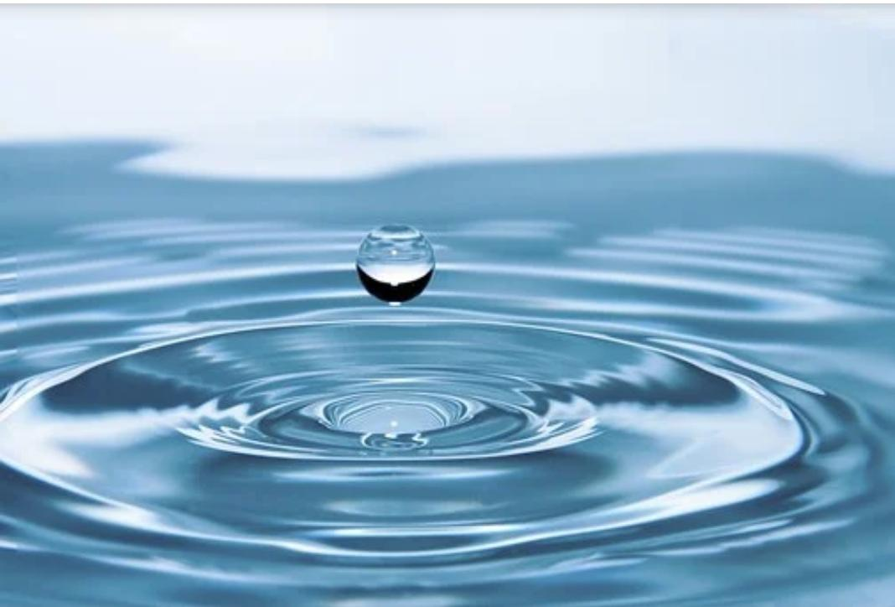

URBAN WATER QUALITY PREDICTION
Using Machine Learning
Algorithms
Smart Bridge-Remote Summer Internship Program

Slide 2

TEAM 4
G.ANJIREDDY 17UK1A05L5
G.RAVALI 17UK1A05M3
I.ANUSHA 17UK1A05L4
A.SAIKUMAR 17UK1A05M4
P.VENKATESHWARBABU 18UK5A0513
Under the guidance of
SHYAM SUNDER

Slide 3
TABLE OF CONTENTS
01 INTRODUCTION
02 ADVANTAGES AND
DISADVANTAGES
03 APPLICATIONS
04 CONCLUSION

Slide 4
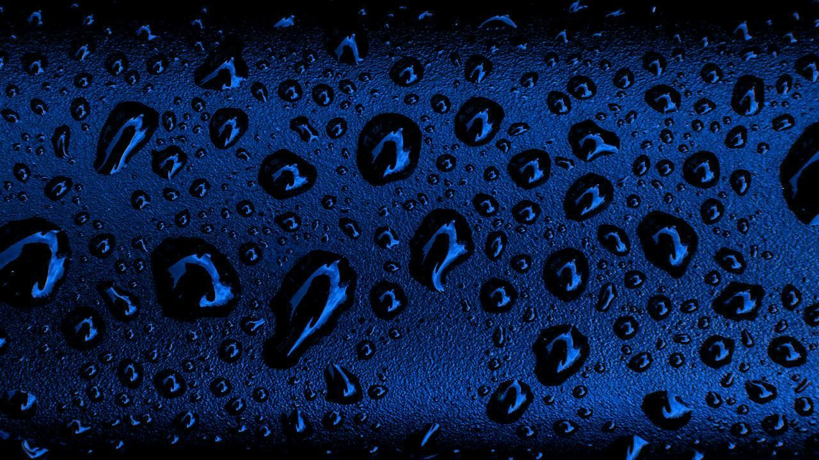
Introduction

Slide 5
1. INTRODUCTION
Water makes up about 70% earth surface and it is one of the most important sources vital to sustaining life. Rapid urbanization and industrialization have led to a deterioration of water quality at an alarming rate, resulting in harrowing diseases. Water quality has been conventionally estimated through expensive and time-consuming lab statistical analysis. With this motivation, this research explores a series of supervised machine learning algorithms to estimate the water quality index of particular year. The proposed methodology employs four input parameters namely pH, conductivity, dissolved oxygen, biochemical oxygen demand. Of all the employed algorithms random forest, decision tree , linear Regression with the degree of 2 predict the WQI most efficiently with an accuracy of 0.96.
The proposed methodology archives reasonable accuracy using a minimal number of parameters to validate the possibility of its use in real-time water quality systems.

Slide 6

PURPOSE ?

Slide 7
PURPOSE OF WATER QUALITY WATER PREDICTION:
Past trends and present status of water quality
Control and Regulation of Water quality
Insights in to future trends
Influence of water quality on environment
Impacts of water quality

Slide 8
SYSTEM DESIGNING
Jupiter notebook
Pandas
Numpy
Regression models
Spyder IDE
Flask app
For creating an user interface for the prediction we used the Flask. It is a micro web framework written in Python. It is classified as a micro framework because it does not require particular tools or libraries. It has no database abstraction layer, form validation, or any other components where pre-existing third-party libraries provide common functions, and a scripting language to create a webpage is HTML by creating the templates to use in the functions of the Flask and HTML.

Slide 9
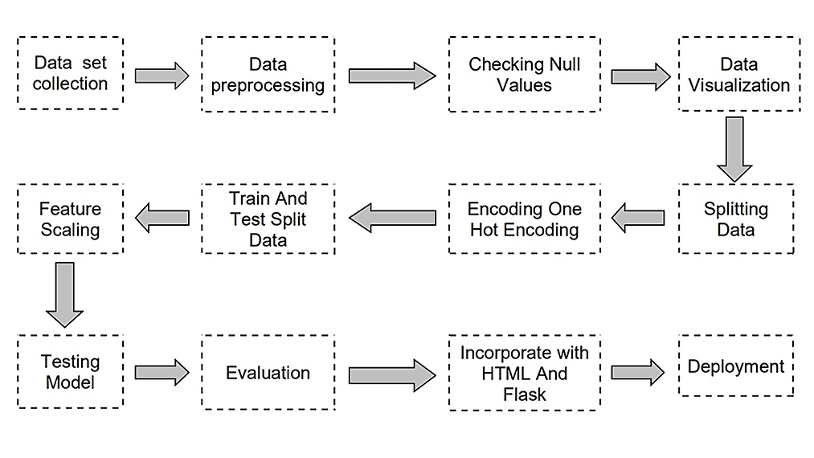
BLOCK DIAGRAM

Slide 10
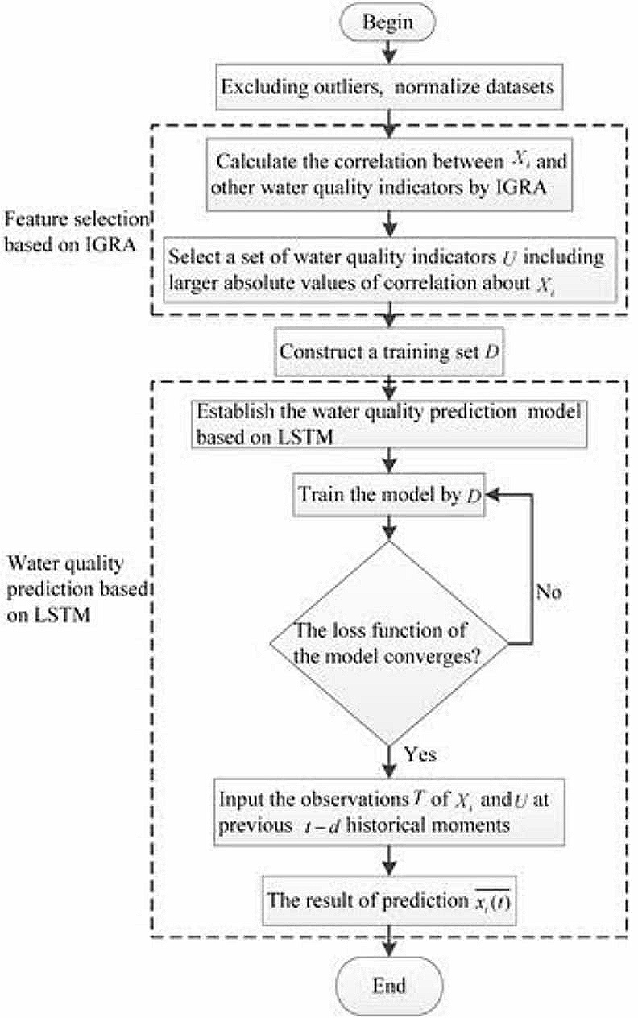
FLOW CHART:

Slide 11
RESULTS
Decision tree algorithm is used to predict its performance, and compared with another two machine learning methods namely the linear regression and the Random Forest. The obtained results are displayed in Table below.
The results show that, the performance of Decision tree have comparable performance than that of random forest and linear regression, but the still performs the best, with an accuracy of 96%, higher than the linear regression with an accuracy of 59%.
S No: | Algorithms Used | Accuracy
1 | Random Forest | 0.96%
2 | Decision Tree | 0.96%
3 | Linear Regression | 0.59%

Slide 12
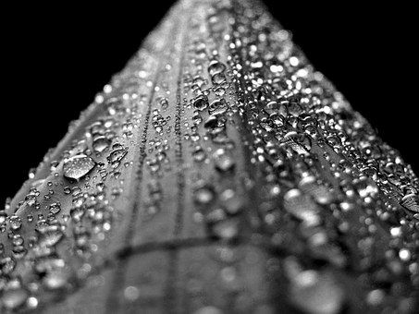
ADVANTAGES
AND
DISADVANTAGES

Slide 13
2. ADVANTAGES AND DISADVANTAGES
Advantages:
Effective predictive model which predicts whether water quality is “High ” or “Low ” for drinking purpose based on water quality parameters.
Prediction of urban water quality help control water pollution and protect human health.
Decision tree give the accurate result of the prediction up to 96% which is the algorithm we used for prediction.
Easy and simple User Interface.
Disadvantages:
It could not work anywhere like an web-application, if one is using other should be quiet.
What may work on some data sets may not necessarily work on others.
Needs more than a single value for the prediction.

Slide 14

APPLICATIONS

Slide 15

3. APPLICATIONS
Application of predictive control strategies to the management of complex networks in the urban water.
Predicting the past and present status of water quality.
In water quality management.
It is one of the most widely used areas of data. The water behaviour with reference to pH, do, co and bod can be analysed.
It can work in real time and predict as soon as the necessary details for prediction are given to the model.

Slide 16

4. CONCLUSION
The experiment shows that the Decision tree algorithm performs outstanding than the other algorithms in the prediction of quality default and has strong ability of generalization.
What may work on some data sets may not necessarily work on others. Therefore, always evaluate methods using cross validation to get a reliable estimates.
Also, we can further improve the performance of the algorithm that can be applied on other data sets by learning algorithms and random research.

Slide 17

THANK YOU
THANK YOU

